Slide 1

CRACKING HASHES WITH HASHCAT

Slide 2
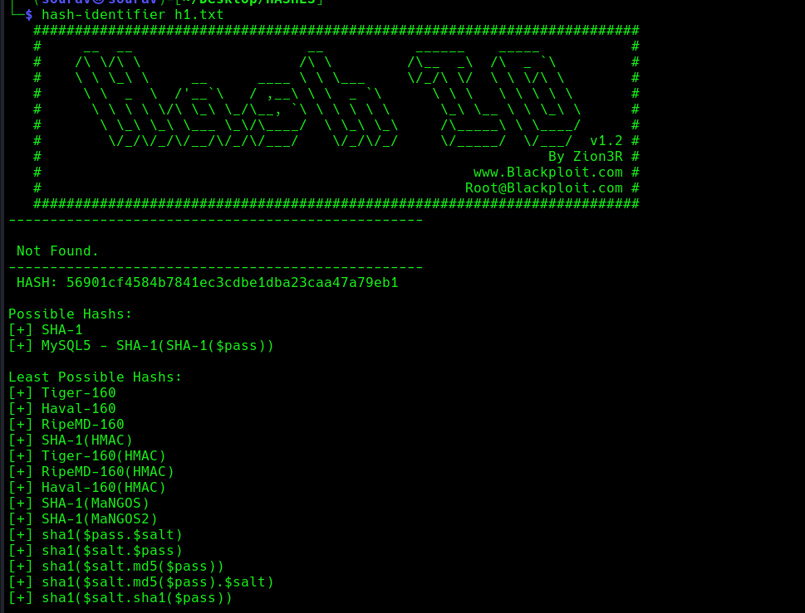
STEP 1
First we need to identify the hash type. Using the hash-identifier we can check for the most to least possible hash types and work our way from there.
STEP 2
Using the hashcat tool we use the SHA-1 hash type and check for possible hashes using the sqlmap wordlist.

Slide 3
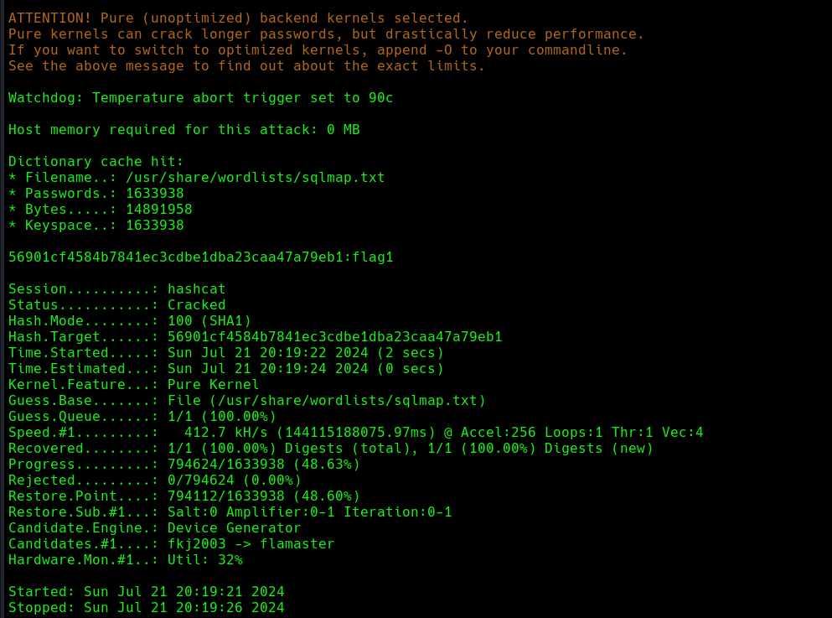
STEP 3
The hashcat has been launched and it has cracked the hash and found the password which is (flag 1) in this scenario.

